Slide 1
MTA Project
By Peter Bloch, Tara Mou, Skye Chen and James Roberts

Slide 2
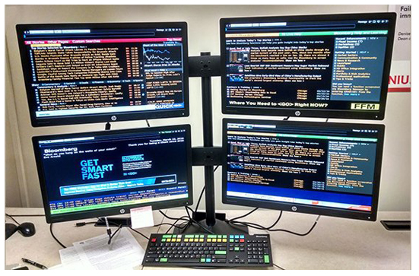
Initial Research
Our preliminary research consisted of examining our target audience and plotting the locations of where they spend their days to find the best group of high-frequency areas.

Slide 3




Initial Research
According to BuiltinNYC, the largest 10 tech companies in New York City are as follows:
Bloomberg 9,000 employees
Oath 1,400
CA Technologies 1,230
Vice Media 1,217
Blue Apron 890
E*Trade 827
BuzzFeed 730
Yext 675
FreshDirect 657
Etsy 622

Slide 4
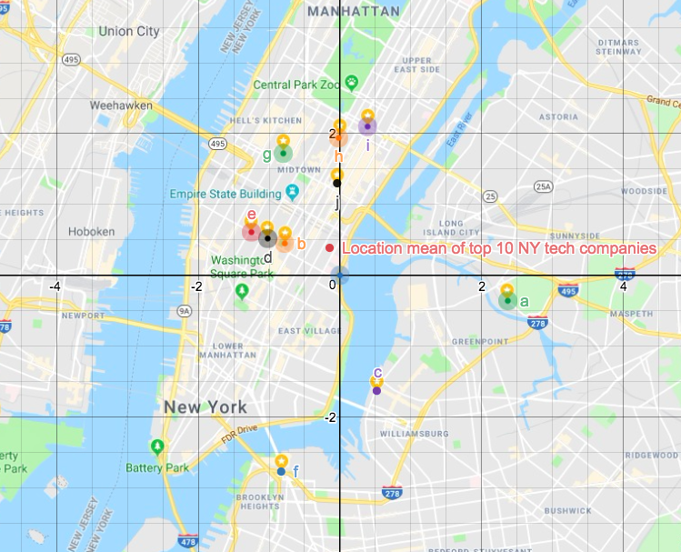

Slide 5
Initial Research
With a marked map of locations, we then superimposed points on each of the major locations to mark their relative coordinates.
Calculated Geographical Mean (unweighted)
Saved Every important MTA stop

Slide 6
Data Frame Setup:
def Stations(MTA):
MTA.columns = MTA.columns.str.strip()
MTA = MTA[(MTA.STATION == '59 ST') | (MTA.STATION =='57 ST') | (MTA.STATION == '5 AVE') | (MTA.STATION == '21 ST-QNSBRIDGE') | (MTA.STATION == '23 ST') | (MTA.STATION =='42 ST-PORT AUTH') | (MTA.STATION == 'CYPRESS AV') | (MTA.STATION == 'YORK ST') | (MTA.STATION == 'BOROUGH HALL') | (MTA.STATION == 'HOYT ST') | (MTA.STATION == 'NEVINS ST')]
MTA = MTA.reset_index(drop=True)
return MTA
Isolation of subway stations

Slide 7
Data Frame Setup:
def time(MTA):
morning=MTA[(MTA.TIME=='05:00:00')|(MTA.TIME=='12:00:00')|(MTA.TIME=='06:00:00')|
(MTA.TIME=='07:00:00')|(MTA.TIME=='08:00:00')|(MTA.TIME=='09:00:00')|(MTA.TIME=='10:00:00')|(MTA.TIME=='11:00:00')|(MTA.TIME=='12:00:00')]
morning=morning.reset_index(drop=True)
return(morning)
def time(MTA):
evening=MTA[(MTA.TIME=='12:00:00')|(MTA.TIME=='13:00:00')|(MTA.TIME=='14:00:00')|(MTA.TIME=='15:00:00')|(MTA.TIME=='16:00:00')|(MTA.TIME=='17:00:00')|(MTA.TIME=='18:00:00')|(MTA.TIME=='19:00:00')|(MTA.TIME=='20:00:00')]
return(evening)
times=time(stations)
Time Setup

Slide 8
Data Frame Setup
def date(MTA):
MTA=MTA[MTA.DATE=='06/10/2017']
MTA=MTA.reset_index(drop=True)
return(MTA)
droped=date(times)
def dic(MTA):
MTA_dict={}
for i in range(len(MTA.index)):
tuple1 = ((MTA['C/A'][i], MTA.UNIT[i], MTA.SCP[i], MTA.STATION[i]))
MTA_dict[tuple1]=MTA_dict.get(tuple1,{})
MTA_dict[tuple1].update({MTA.TIME[i]:MTA.EXITS[i]})
return(MTA_dict)
dic1=dic(droped)

Slide 9
Data Frame Setup
def delete(MTA):
to_delete = []
for key,value in MTA.items():
if len(value)!=2:
to_delete.append(key)
for i in to_delete:
del MTA[i]
return(MTA)
deleted_dict=delete(dic1)
def morningdif(mordict):
morning_differences = {}
for key,value in mordict.items():
newkey = (key[0],key[1],key[3])
val = []
SCP = key[2]
for key1, val1 in value.items():
val.append(val1)
dif = val[1]-val[0]
if newkey not in morning_differences:
morning_differences[newkey] = {SCP : dif}
else:
morning_differences[newkey][SCP] = dif
return(morning_differences)
morningdiff=morningdif(deleted_dict)

Slide 10
Data Frame Setup
def totalnum (morningdif):
total_morning_diff={}
for key,value in morningdif.items():
total=[]
for key1,value1 in value.items():
total.append(value1)
sum1=sum(total)
total_morning_diff[key]=total_morning_diff.get(key,0)+sum1
return (total_morning_diff)
total=totalnum(morningdiff)

Slide 11
Data Frame Setup
def rank(totalnum):
list1=[]
for key2,value2 in totalnum.items():
if key2 not in list1:
list1.append((value2,key2))
list1.sort(reverse=True)
return(list1)
ranked=rank(total)
print(ranked)

Slide 12
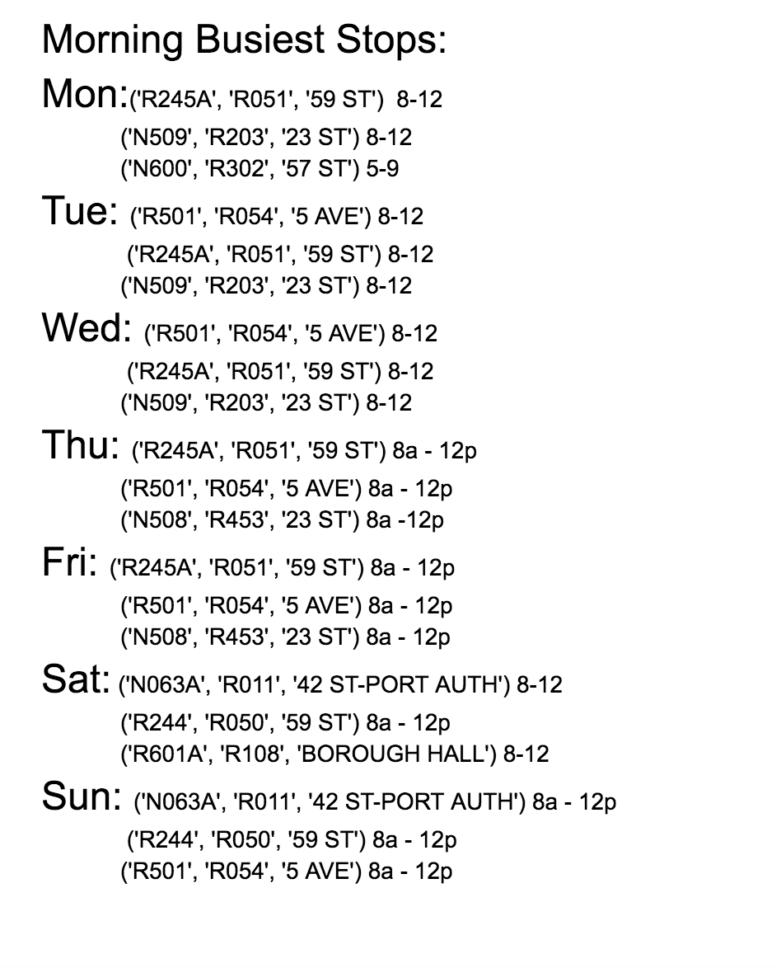
How did we use our code and the output?
Change the dates using generic date function (June 10- June 17)
def date(MTA):
MTA=MTA[MTA.DATE=='06/10/2017']
MTA=MTA.reset_index(drop=True)
return(MTA)
Record the top 3 busiest stops for morning and top 2 for afternoon.
Find the station’s corresponding time frame using dictionary.

Slide 13
Data Analysis
Sorted using the Ranked function
Top three stops were then picked
Run through the program to determine the time frame
Model Output for Saturday, 6/10:
(3401, ('N063A', 'R011', '42 ST-PORT AUTH')), (2088, ('R244', 'R050', '59 ST')), (1994, ('R601A', 'R108', 'BOROUGH HALL')), (1512, ('N077', 'R111', '23 ST')) …

Slide 14
Results
Example Monday Morning Results
5856 ('R245A', 'R051', '59 ST') 8-12
5020 ('N509', 'R203', '23 ST') 8-12
4440 ('N600', 'R302', '57 ST') 8-12

Slide 15
Results
Example Monday Afternoon Results:
3536 ('N062A', 'R010', '42 ST-PORT AUTH') 2p - 6p
2025 ('R226', 'R131', '23 ST') 1p - 5p

Slide 16
Volunteer Schedule Plan
Morning Crew:
Teams consist of pairs
Teams 1, 2, and 3 work from 8:00 am to 12:00 pm
Team 4 works from 2:00 pm to 6:00 pm
Team 5 works from 1:00 pm to 5:00 pm

